Slide 1


Department of Computer Science and Engineering
CS19643 – FOUNDATIONS OF MACHINE LEARNING
DIABETES DETECTION SYSTEM
Agnes C
210701019
Anto Roshan P 210701029
Dr.S. Vinodkumar
Professor

Slide 2
Abstract
This project develops a diabetes detection system using the Support Vector Machine (SVM) algorithm. It begins with collecting data from electronic health records, patient surveys, and wearable devices. The data is cleaned and normalized to ensure accuracy. Relevant features are identified and used to train the SVM model, which learns to distinguish between diabetic and non-diabetic cases. The model's performance is evaluated using metrics like accuracy and AUC, ensuring it is reliable. Once validated, the model is deployed with APIs and a user-friendly interface for real-time use. Continuous monitoring and periodic retraining keep the system accurate over time, helping with early diagnosis and effective management of diabetes.

Slide 3
Existing System
Existing diabetes detection systems using machine learning face several disadvantages. First, they often rely on high-quality, comprehensive datasets, which may not always be available, leading to biased or inaccurate predictions. Second, data preprocessing is time-consuming and complex, requiring significant effort to clean and standardize data. Third, feature selection can be challenging, potentially overlooking important variables. Fourth, the chosen algorithms may not always generalize well to new, unseen data, reducing their effectiveness. Additionally, these systems require continuous monitoring and regular updates to maintain accuracy, which can be resource-intensive. Finally, integrating these models into clinical workflows can be difficult, necessitating user-friendly interfaces and robust API integrations, which add to development complexity and costs.

Slide 4
Proposed System
The proposed diabetes detection system harnessing the Support Vector Machine (SVM) algorithm offers several significant advantages. With its renowned accuracy and robustness to overfitting, SVMs provide reliable predictions, crucial for early diagnosis and effective management of diabetes. Their flexibility in handling both linear and non-linear relationships between features ensures the detection of complex patterns in the data, while their efficiency with high-dimensional datasets makes them suitable for healthcare analytics. SVMs also offer interpretability through clear decision boundaries, facilitating understanding by healthcare professionals. Moreover, their tuning options allow for customization to optimize performance for specific datasets, while their ease of deployment and scalability make them ideal for integration into clinical workflows. In essence, the proposed system leveraging SVMs presents a versatile, accurate, and efficient approach to diabetes detection.

Slide 5
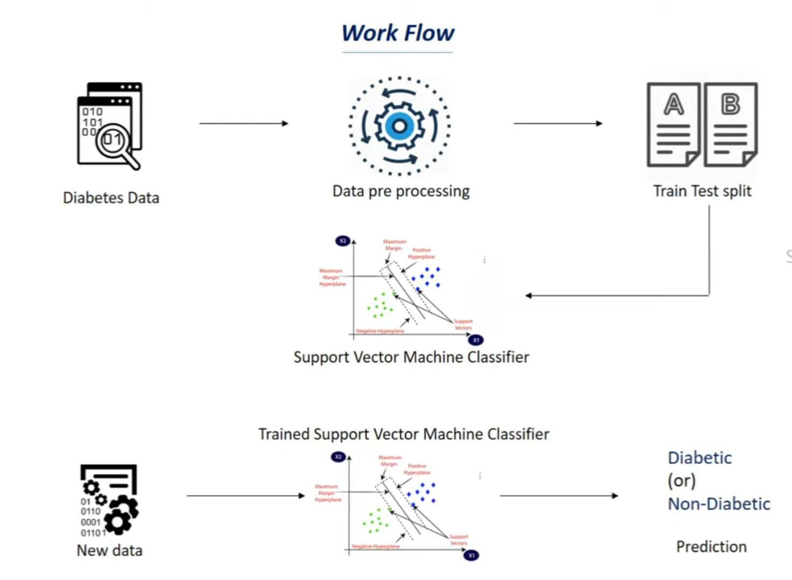
System Architecture

Slide 6
List of Modules
Data collection module
Data preprocessing Module
Feature selection and standardization
Model Training Module
Model Evaluation Module
Deployment module

Slide 7
Functional Description for each modules
Data Collection Module: This module serves as the foundation of the system, gathering diverse datasets from sources like electronic health records, patient surveys, and wearable devices. It ensures comprehensive data acquisition, vital for accurate diabetes detection and analysis.

Slide 8
Functional Description of Module
Data Preprocessing Module: Responsible for preparing the collected data for analysis, this module addresses issues like missing values, outliers, and inconsistencies. It standardizes and normalizes features, ensuring uniformity and accuracy in subsequent processing steps.

Slide 9
Functional Description of Module
Feature Selection and Standardization: Identifies the most relevant features for diabetes prediction and standardizes them to a common scale. This module enhances the model's performance by prioritizing informative variables and ensuring consistency across features.

Slide 10
Functional Description of Module
Model Training: Trains the machine learning model, such as Support Vector Machines (SVM), on the prepared dataset to learn patterns and relationships between features and diabetes status. It optimizes model parameters to achieve accurate predictions.

Slide 11
Functional Description of Module
Model Evaluation: Rigorously assesses the trained model's performance using metrics like accuracy, precision, recall, and F1-score. Cross-validation techniques validate the model's robustness and generalizability.

Slide 12
Functional Description of Module
Deployment Module: Integrates the trained model into real-world applications, providing interfaces for seamless interaction with healthcare systems. This module ensures accessibility and usability of the system for healthcare professionals, facilitating its practical implementation.

Slide 13
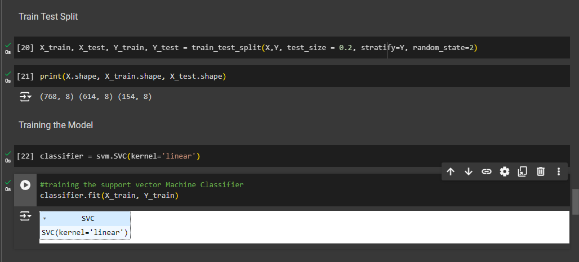
Output

Slide 14
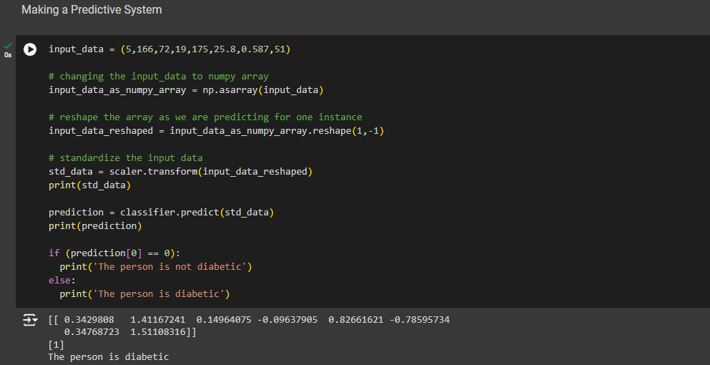
Output

Slide 15
REFERENCES
[1] UCI Machine Learning Repository: Pima Indians Diabetes Database. Available at: UCI Machine Learning Repository
[2] American Diabetes Association. (2023). Standards of Medical Care in Diabetes—2023. Diabetes Care, 46(Supplement_1), S1-S292. doi:10.2337/dc23-Sint
[3] Pedregosa, F., Varoquaux, G., Gramfort, A., Michel, V., Thirion, B., Grisel, O., ... & Duchesnay, E. (2011). Scikit-learn: Machine Learning in Python. Journal of Machine Learning Research, 12, 2825-2830. Available at: Scikit-learn JMLR paper
[4] Hastie, T., Tibshirani, R., & Friedman, J. (2009). The Elements of Statistical Learning: Data Mining, Inference, and Prediction. 2nd edition. Springer. doi:10.1007/978-0-387-84858-7
[5] Kingma, D. P., & Ba, J. (2014). Adam: A Method for Stochastic Optimization. arXiv preprint arXiv:1412.6980. Available at: Adam Optimizer

Slide 16
REFERENCES
[6] Bishop, C. M. (2006). Pattern Recognition and Machine Learning. Springer. doi:10.1007/978-0-387-45528-0
[7] Wang, L., Pedrycz, W., & Shyi-Ming, C. (2012). Feature selection and data preprocessing for classification: An integrated approach. Neurocomputing, 93, 4-12. doi:10.1016/j.neucom.2012.03.013
[8] Han, J., Pei, J., & Kamber, M. (2011). Data Mining: Concepts and Techniques. 3rd edition. Morgan Kaufmann. doi:10.1016/C2009-0-61819-5
[9] Nguyen, T., Tran, T., Wickramasinghe, N., & Venkatesh, S. (2017). Deepr: A Convolutional Net for Medical Records. IEEE Journal of Biomedical and Health Informatics, 21(1), 22-30. doi:10.1109/JBHI.2016.2633963
[10] Raschka, S., & Mirjalili, V. (2017). Python Machine Learning. 2nd edition. Packt Publishing. Available at: Python Machine Learning Book

Slide 17
CONCLUSION
In conclusion, the development of a diabetes detection system utilizing machine learning techniques represents a significant advancement in healthcare technology. By leveraging modules such as data collection, preprocessing, feature selection, model training, evaluation, and deployment, the system can provide accurate and timely predictions, aiding in early diagnosis and effective management of diabetes. The integration of advanced algorithms like Support Vector Machines (SVM) offers robustness and scalability, ensuring the system's reliability in real-world healthcare settings. Continued research and development in this field hold promise for further improvements, ultimately leading to enhanced patient outcomes and quality of care in diabetes management.

Slide 18
Thank You!

